Slide 1
Design recap
SoP (ANDs-OR) → NAND
PoS (ORs-AND) → NOR d

Slide 2
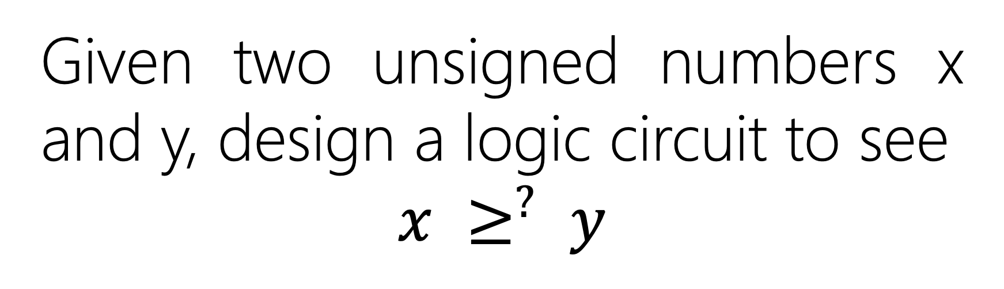
Given two unsigned numbers x and y, design a logic circuit to see
$$x ≥^{?} y$$

Slide 3

Solution 1: x – y, if no last borrow
$$x ≥^{?} y$$

Slide 4

Solution 2: logic circuit
$$x ≥^{?} y$$

Slide 5

Solution 2: logic circuit
What is the range of x and y?
$$x ≥^{?} y$$

Slide 6

Solution 2: logic circuit
What is the range of x and y?
$$x,y∈[0, 3]10$$

Slide 7
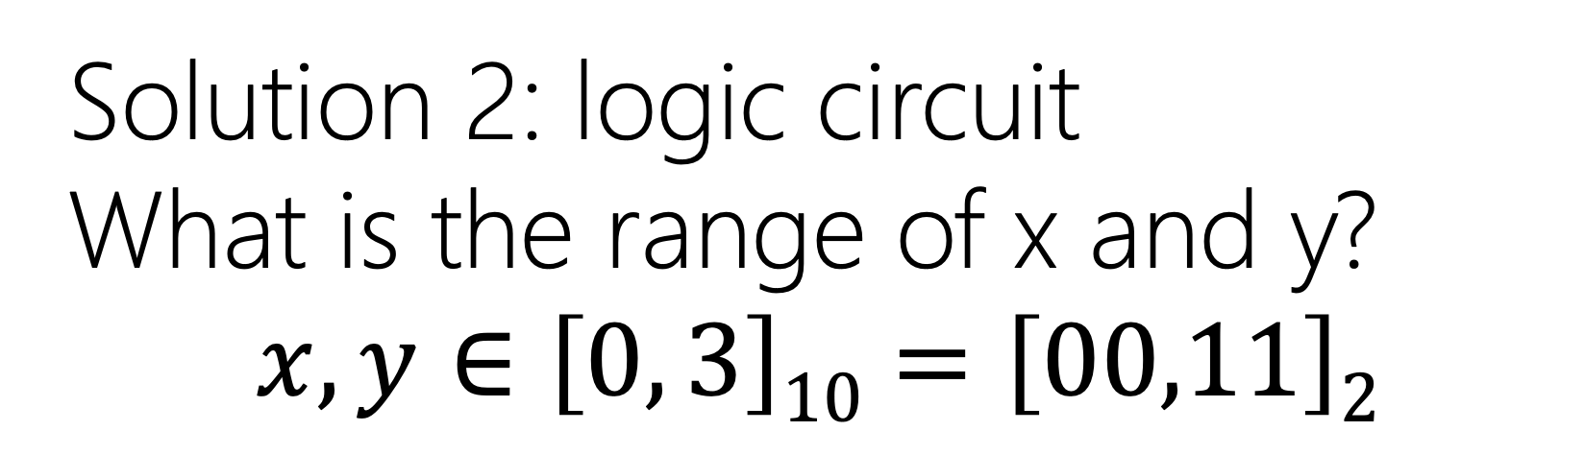
Solution 2: logic circuit
What is the range of x and y?
$$x,y∈\left[0, 3\right]10=\left[00,11\right]2$$

Slide 8

Solution 2: logic circuit
What is the range of output?
$$F∈\{0, 1\}$$

Slide 9
Y2 | Y1 | X2 | X1 | F(Y2,Y1,X2,X1)=?
0 | 0 | 0 | 0 | 1
0 | 0 | 0 | 1 | 1
0 | 0 | 1 | 0 | 1
0 | 0 | 1 | 1 | 1
0 | 1 | 0 | 0 | 0
0 | 1 | 0 | 1 | 1
0 | 1 | 1 | 0 | 1
0 | 1 | 1 | 1 | 1
1 | 0 | 0 | 0 | 0
1 | 0 | 0 | 1 | 0
1 | 0 | 1 | 0 | 1
1 | 0 | 1 | 1 | 1
1 | 1 | 0 | 0 | 0
1 | 1 | 0 | 1 | 0
1 | 1 | 1 | 0 | 0
1 | 1 | 1 | 1 | 1

Slide 10
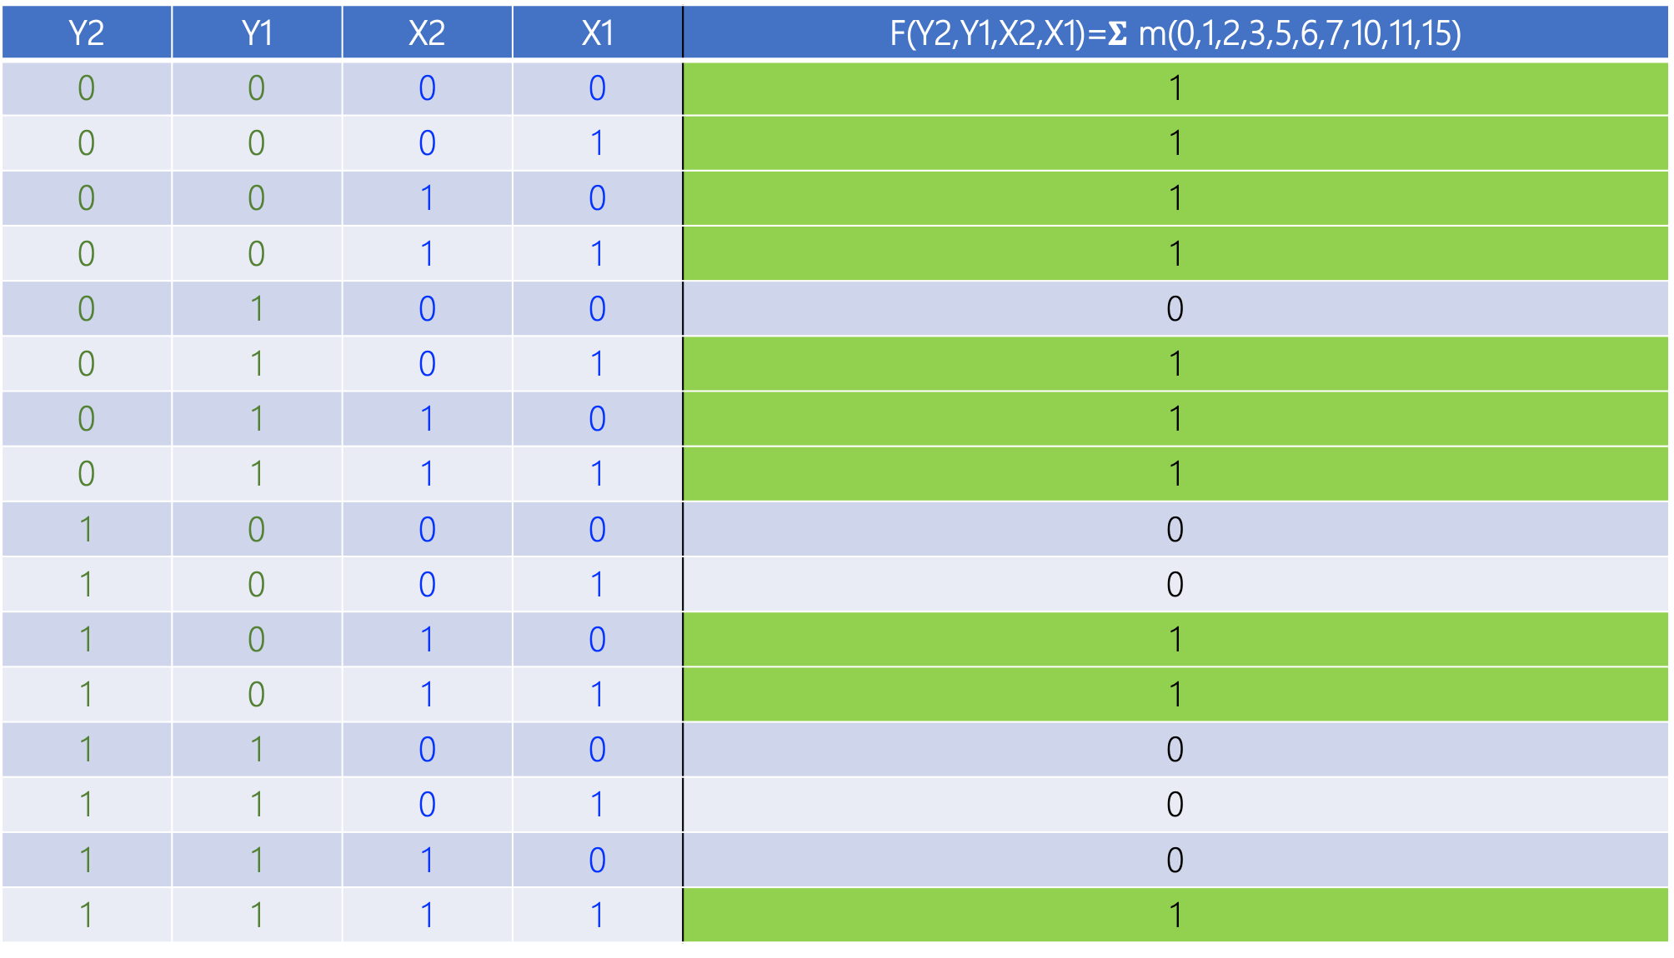
Y2 | Y1 | X2 | X1 | F(Y2,Y1,X2,X1)=$Σ$ m(0,1,2,3,5,6,7,10,11,15)
0 | 0 | 0 | 0 | 1
0 | 0 | 0 | 1 | 1
0 | 0 | 1 | 0 | 1
0 | 0 | 1 | 1 | 1
0 | 1 | 0 | 0 | 0
0 | 1 | 0 | 1 | 1
0 | 1 | 1 | 0 | 1
0 | 1 | 1 | 1 | 1
1 | 0 | 0 | 0 | 0
1 | 0 | 0 | 1 | 0
1 | 0 | 1 | 0 | 1
1 | 0 | 1 | 1 | 1
1 | 1 | 0 | 0 | 0
1 | 1 | 0 | 1 | 0
1 | 1 | 1 | 0 | 0
1 | 1 | 1 | 1 | 1

Slide 11
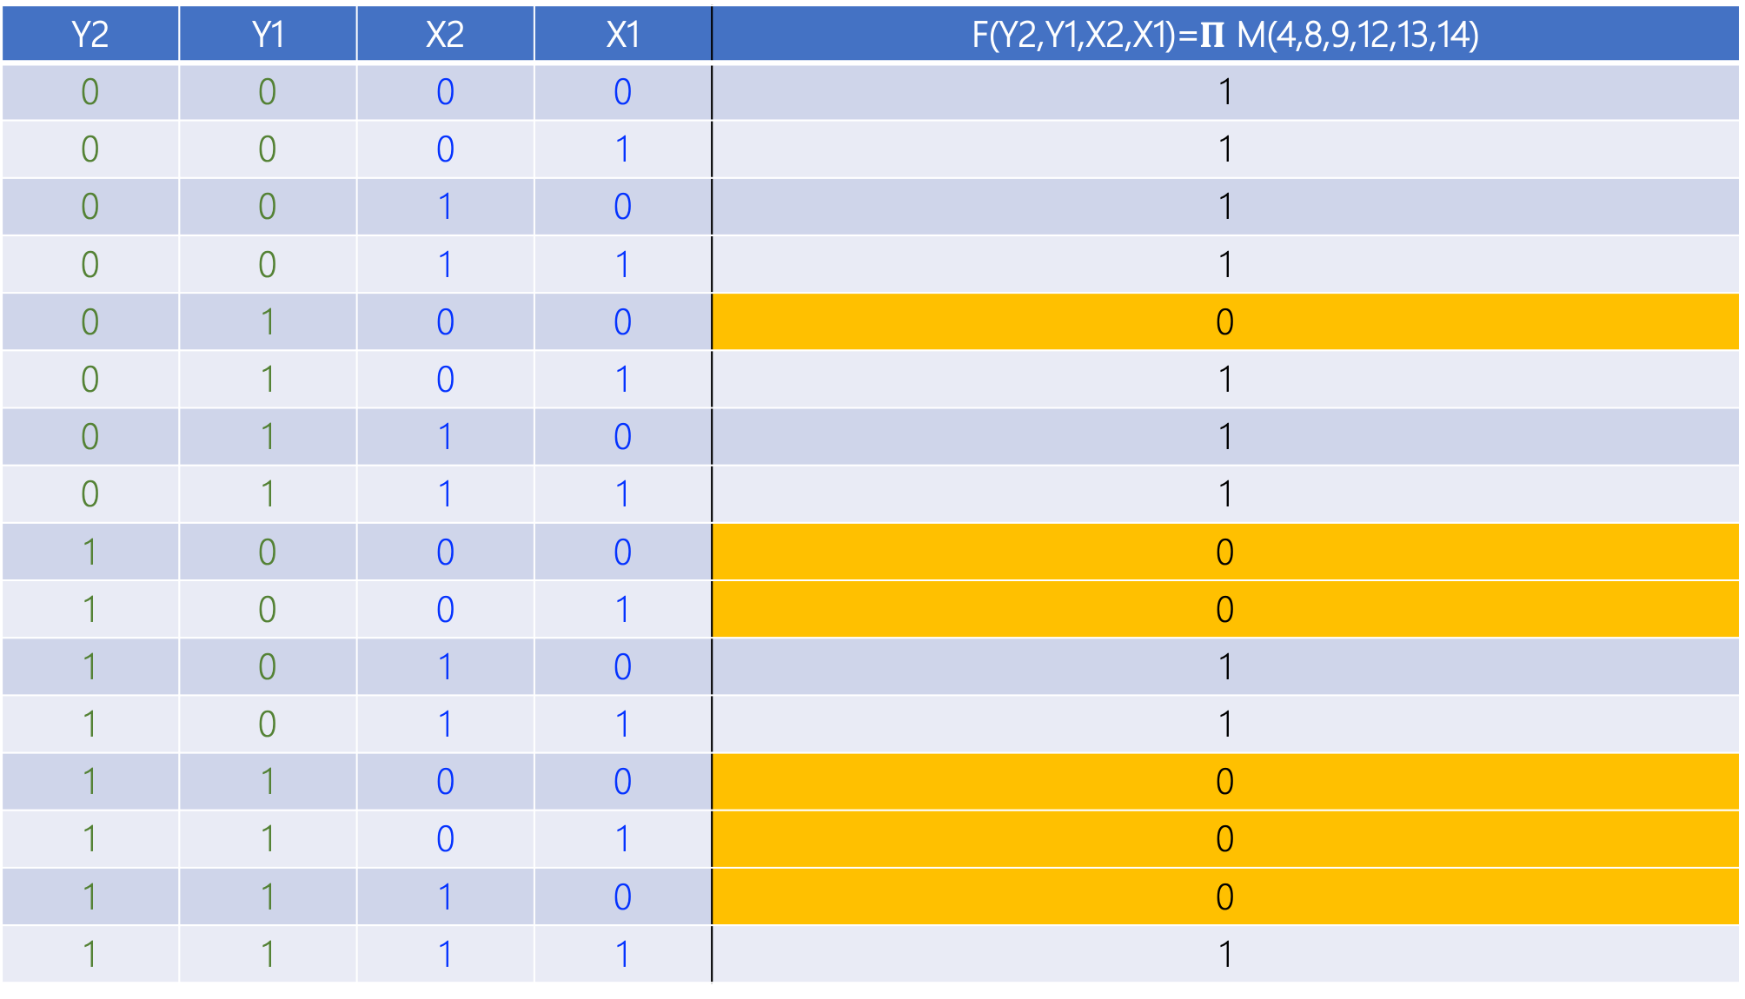
Y2 | Y1 | X2 | X1 | F(Y2,Y1,X2,X1)=$Π$ M(4,8,9,12,13,14)
0 | 0 | 0 | 0 | 1
0 | 0 | 0 | 1 | 1
0 | 0 | 1 | 0 | 1
0 | 0 | 1 | 1 | 1
0 | 1 | 0 | 0 | 0
0 | 1 | 0 | 1 | 1
0 | 1 | 1 | 0 | 1
0 | 1 | 1 | 1 | 1
1 | 0 | 0 | 0 | 0
1 | 0 | 0 | 1 | 0
1 | 0 | 1 | 0 | 1
1 | 0 | 1 | 1 | 1
1 | 1 | 0 | 0 | 0
1 | 1 | 0 | 1 | 0
1 | 1 | 1 | 0 | 0
1 | 1 | 1 | 1 | 1

Slide 12
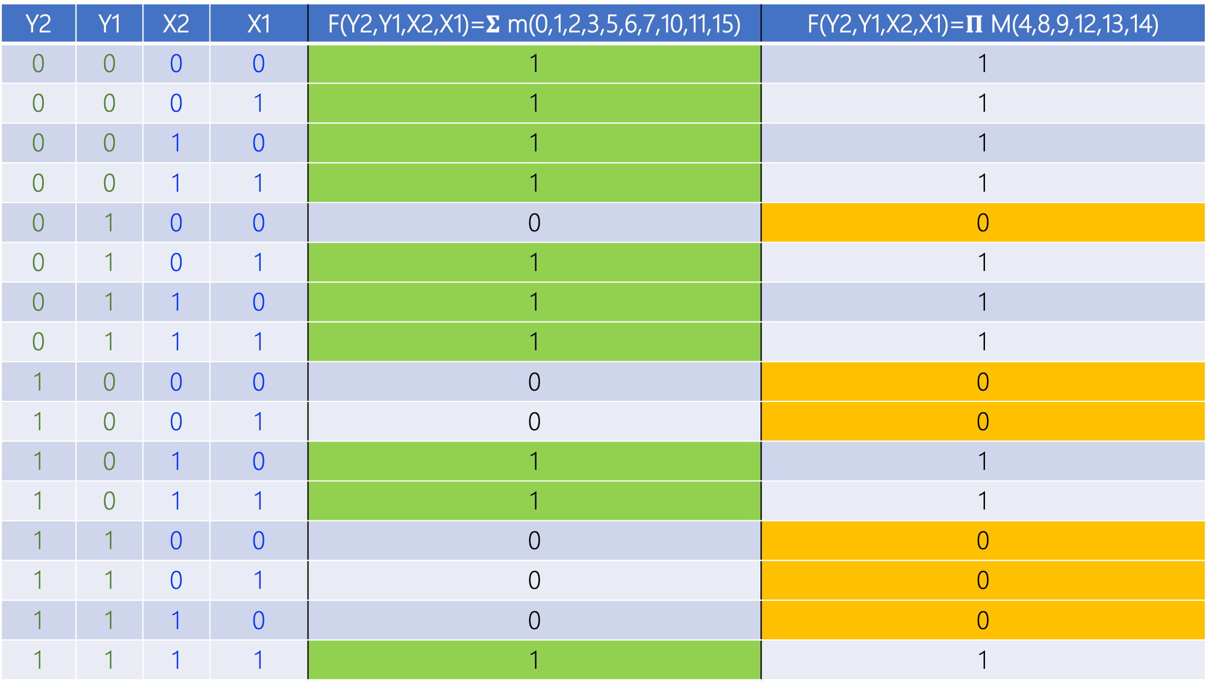
Y2 | Y1 | X2 | X1 | F(Y2,Y1,X2,X1)=$Σ$ m(0,1,2,3,5,6,7,10,11,15) | F(Y2,Y1,X2,X1)=$Π$ M(4,8,9,12,13,14)
0 | 0 | 0 | 0 | 1 | 1
0 | 0 | 0 | 1 | 1 | 1
0 | 0 | 1 | 0 | 1 | 1
0 | 0 | 1 | 1 | 1 | 1
0 | 1 | 0 | 0 | 0 | 0
0 | 1 | 0 | 1 | 1 | 1
0 | 1 | 1 | 0 | 1 | 1
0 | 1 | 1 | 1 | 1 | 1
1 | 0 | 0 | 0 | 0 | 0
1 | 0 | 0 | 1 | 0 | 0
1 | 0 | 1 | 0 | 1 | 1
1 | 0 | 1 | 1 | 1 | 1
1 | 1 | 0 | 0 | 0 | 0
1 | 1 | 0 | 1 | 0 | 0
1 | 1 | 1 | 0 | 0 | 0
1 | 1 | 1 | 1 | 1 | 1

Slide 13
Which design?

Slide 14
Which design?
SoP and PoS are both effective
SoP and PoS have same efficiency (2-levels)

Slide 15
Which design?
Cost: How many gates in SoP vs. PoS?

Slide 16
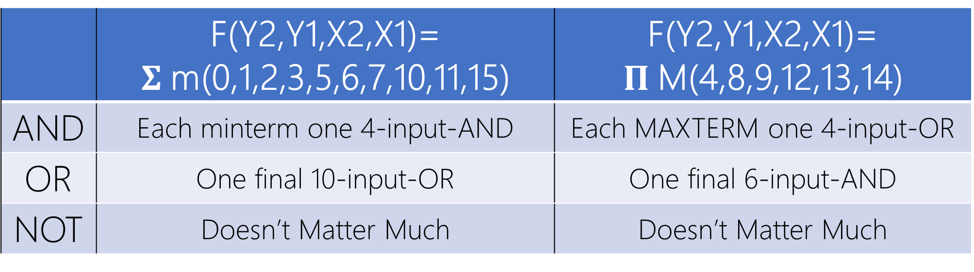
 | F(Y2,Y1,X2,X1)= $Σ$m(0,1,2,3,5,6,7,10,11,15) | F(Y2,Y1,X2,X1)= $Π$M(4,8,9,12,13,14)
AND | Each minterm one 4-input-AND | Each MAXTERM one 4-input-OR
OR | One final 10-input-OR | One final 6-input-AND
NOT | Doesn’t Matter Much | Doesn’t Matter Much

Slide 17
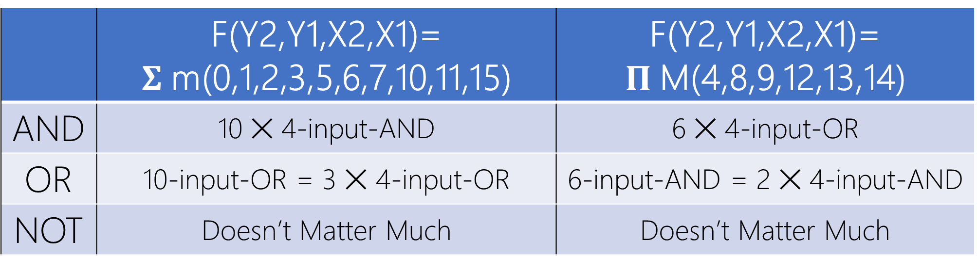
 | F(Y2,Y1,X2,X1)= $Σ$m(0,1,2,3,5,6,7,10,11,15) | F(Y2,Y1,X2,X1)= $Π$M(4,8,9,12,13,14)
AND | 10 ✕ 4-input-AND | 6 ✕ 4-input-OR
OR | 10-input-OR = 3 ✕ 4-input-OR | 6-input-AND = 2 ✕ 4-input-AND
NOT | Doesn’t Matter Much | Doesn’t Matter Much

Slide 18
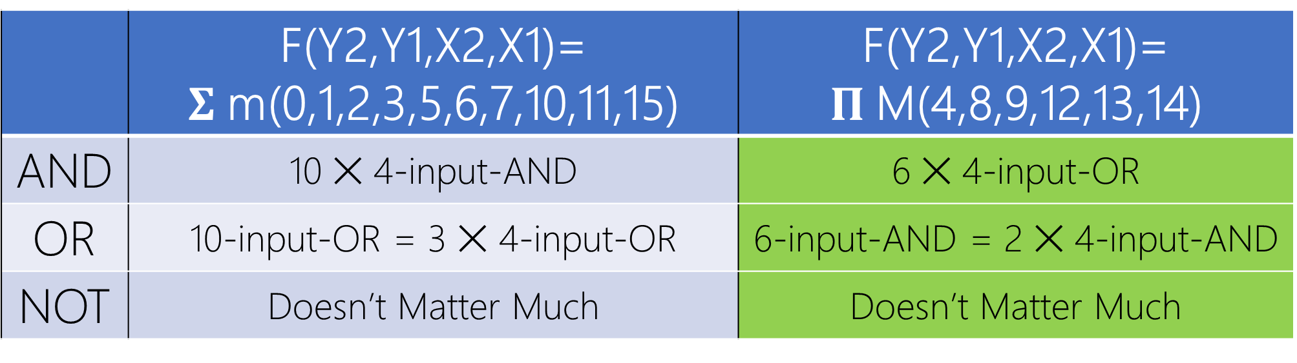
 | F(Y2,Y1,X2,X1)= $Σ$m(0,1,2,3,5,6,7,10,11,15) | F(Y2,Y1,X2,X1)= $Π$M(4,8,9,12,13,14)
AND | 10 ✕ 4-input-AND | 6 ✕ 4-input-OR
OR | 10-input-OR = 3 ✕ 4-input-OR | 6-input-AND = 2 ✕ 4-input-AND
NOT | Doesn’t Matter Much | Doesn’t Matter Much

Slide 19
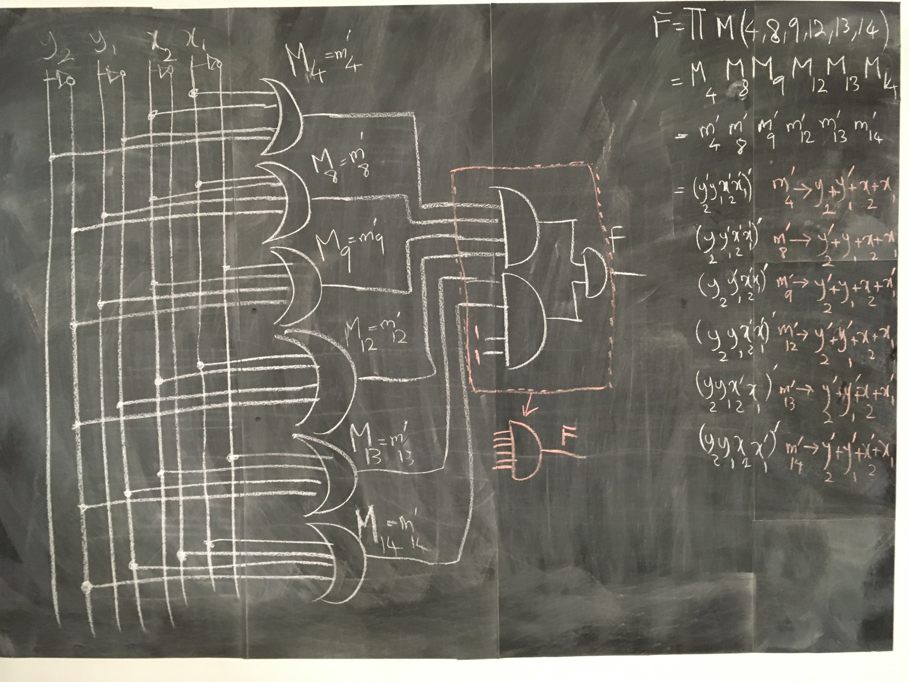

Slide 20
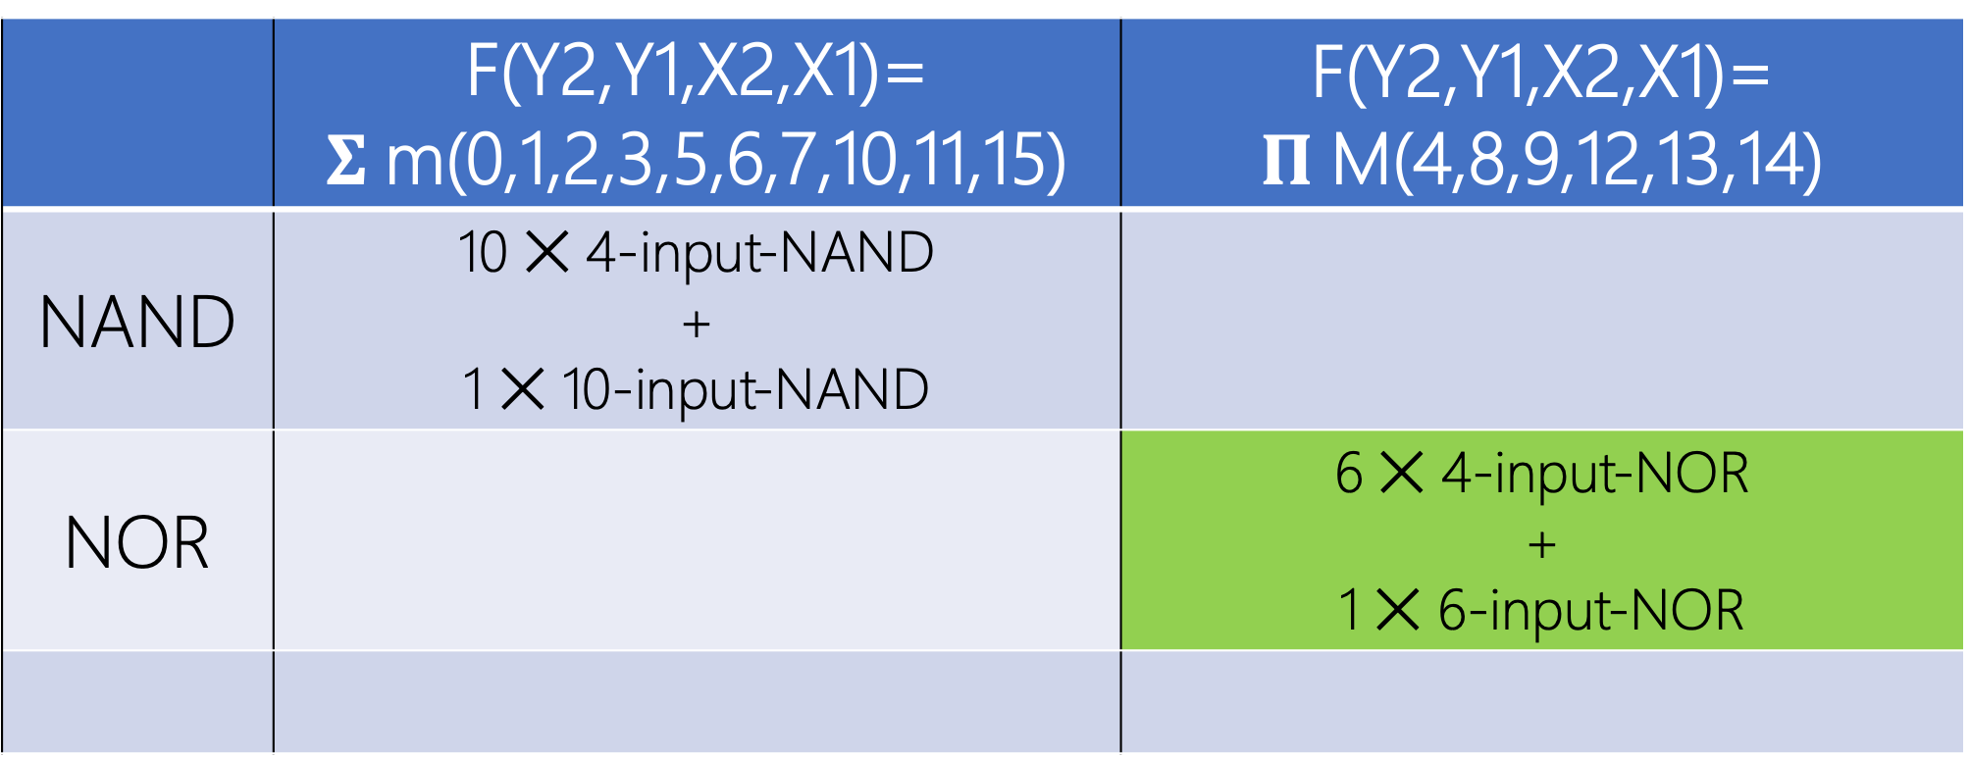
 | F(Y2,Y1,X2,X1)= $Σ$m(0,1,2,3,5,6,7,10,11,15) | F(Y2,Y1,X2,X1)= $Π$M(4,8,9,12,13,14)
NAND | 10 ✕ 4-input-NAND + 1 ✕ 10-input-NAND
NOR |  | 6 ✕ 4-input-NOR + 1 ✕ 6-input-NOR

Slide 21
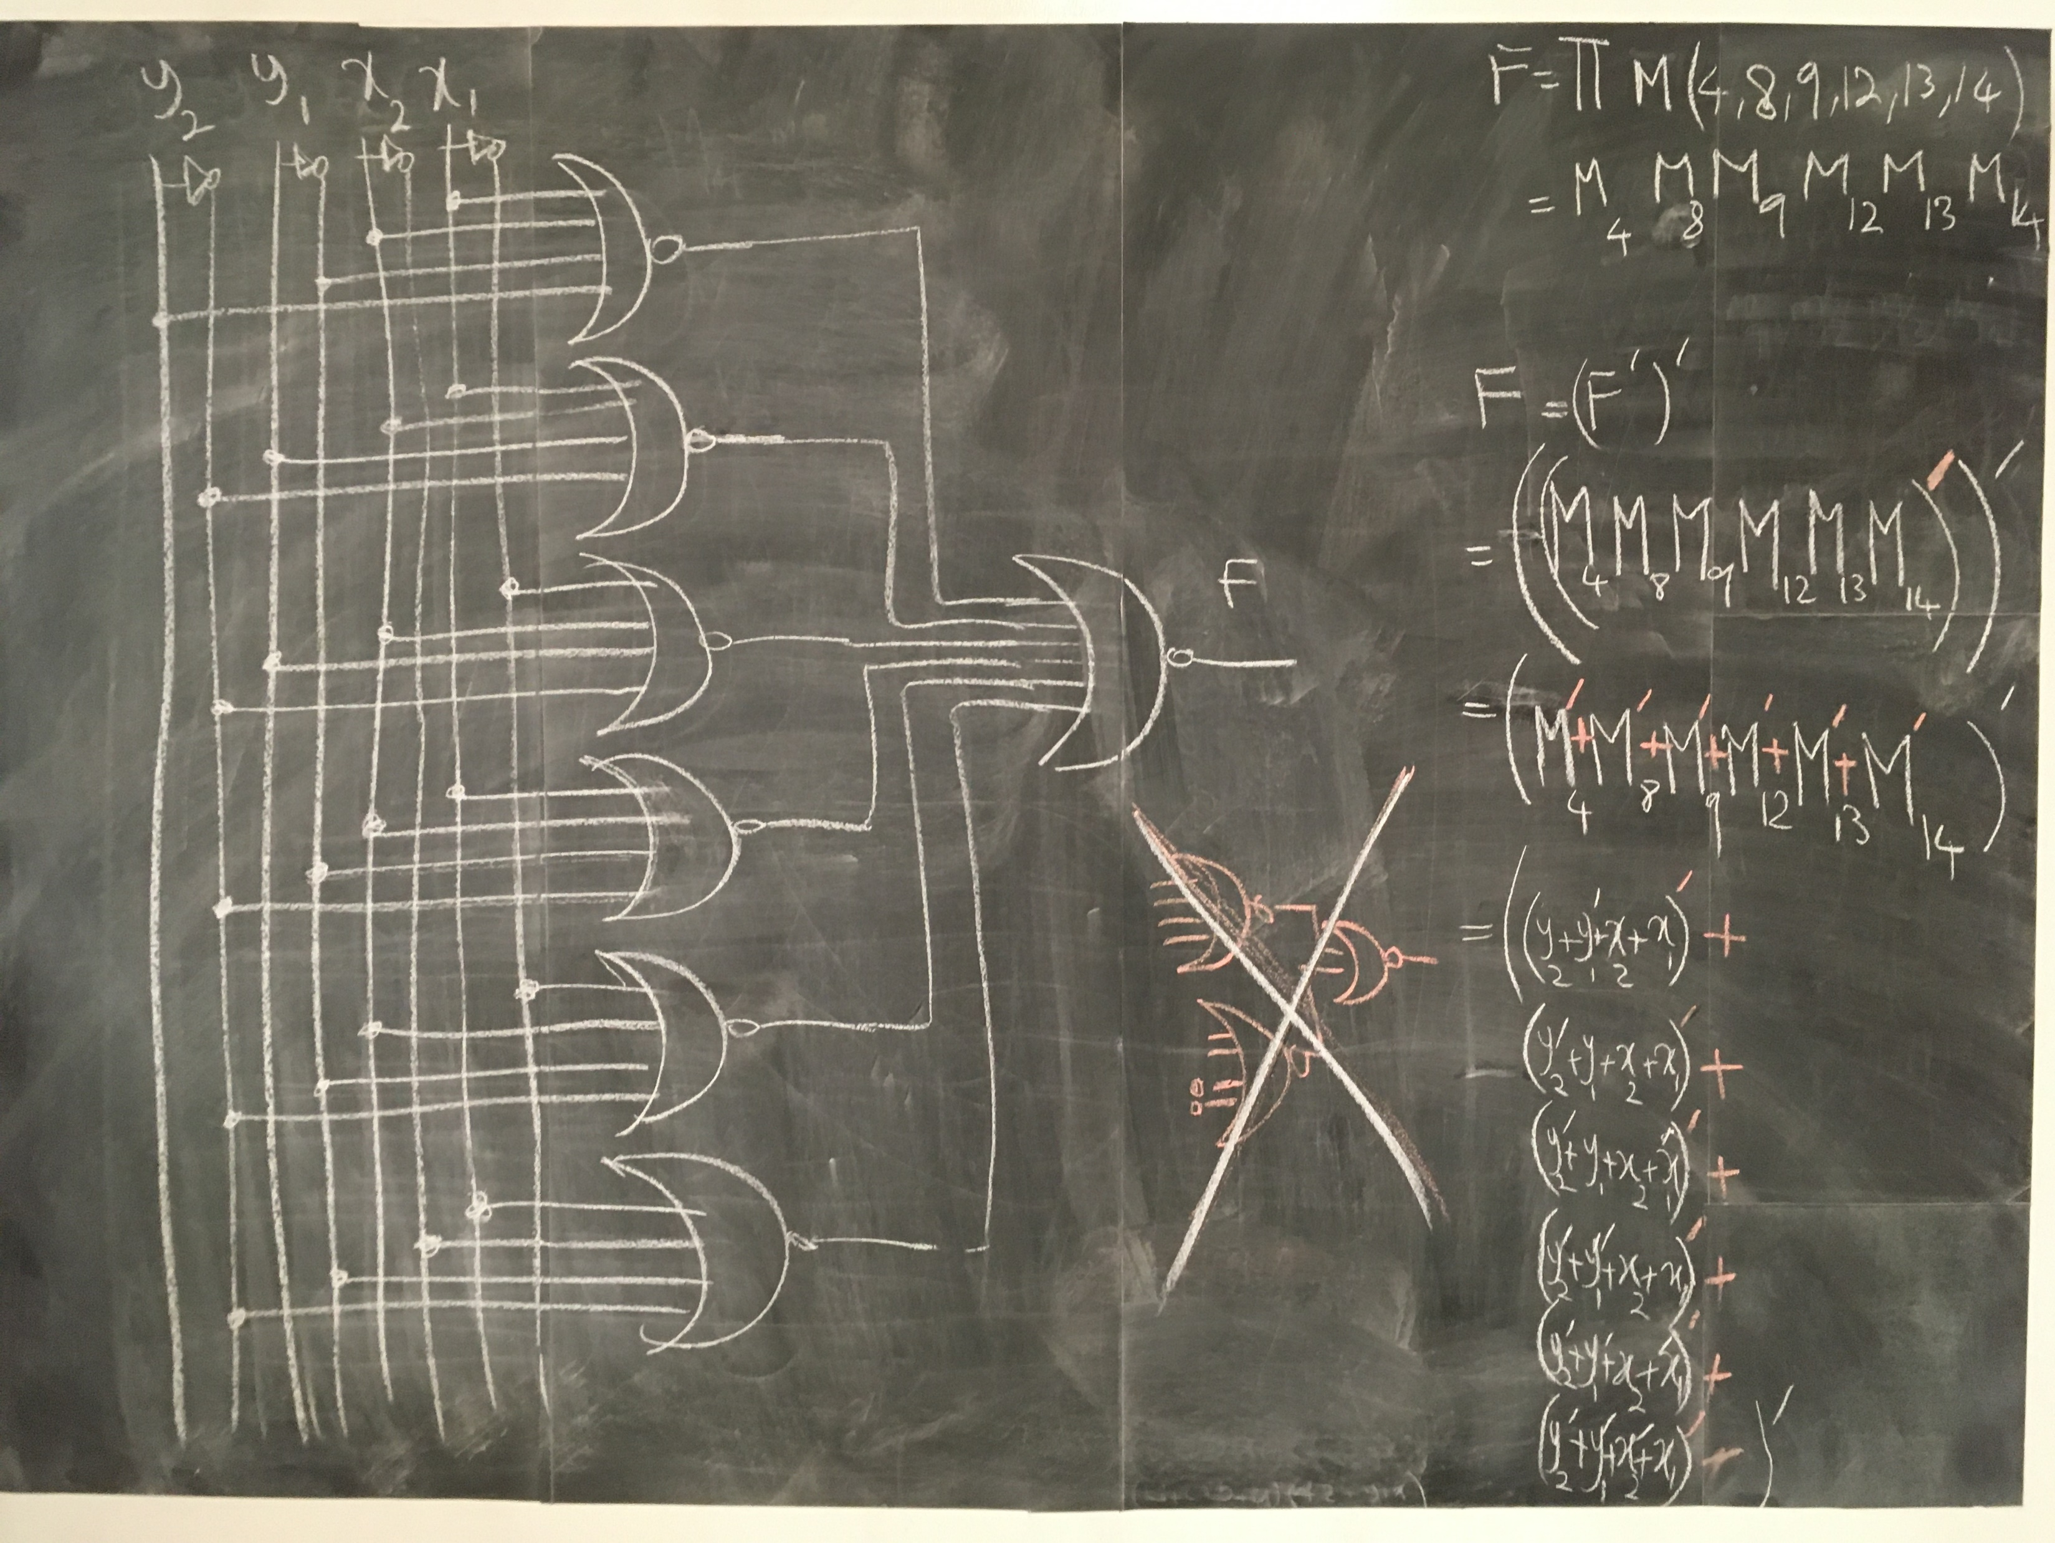

Slide 22
Minimization
aka. Simplification

Slide 23
Minimization
Number of Gates
Number of Inputs (2-input vs 4-input)
Number of Interconnections
Propagation Time
Cost of Gates
Circuit Area
. . .
A circuit may not satisfy all due to conflicting constraints!

Slide 24
Minimization
aka. Simplification
SoP (ANDs-OR) → Simplify → NAND
PoS (ORs-AND) → Simplify → NOR d

Slide 25
Minimization
Boolean Algebra (algebraically)

Slide 26
Minimization
II) Map (Karnaugh map, K-map)

Slide 27
algebra
A set of elements
A set of operators
A set of axioms | postulates | assumptions | definitions

Slide 28
algebra
A set of elements: e.g.,
{0,1}
{-1,0,1}
{1,2,3,4,…}
{…, -2,-1,0,1,2,…}

Slide 29

algebra
A set of operators
{+, ×}
{+, $−$, ×, ÷}
{~, ≤, ≥}

Slide 30
algebra
Unary: !x, -x, x’, …
Binary: x+y, x÷y, x^y, …
Ternary: x?y:z (Elvis), x BETWEEN y AND z (SQL)

Slide 31
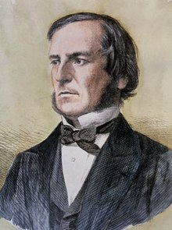
George Boole (/buːl/)
Mathematician
Philosopher
Logician
The Laws of Thought (1854)
Boolean Algebra!
Notes:
The cost of circuits that implement binary logic in all of today’s digital devices and computers is an important factor addressed by designers—be they computer engineers, electrical engineers, or computer scientists.
Finding simpler and cheaper, but equivalent, realizations of a circuit can reap huge payoffs in reducing the overall cost of the design. Mathematical methods that simplify circuits rely primarily on Boolean algebra.

Slide 32
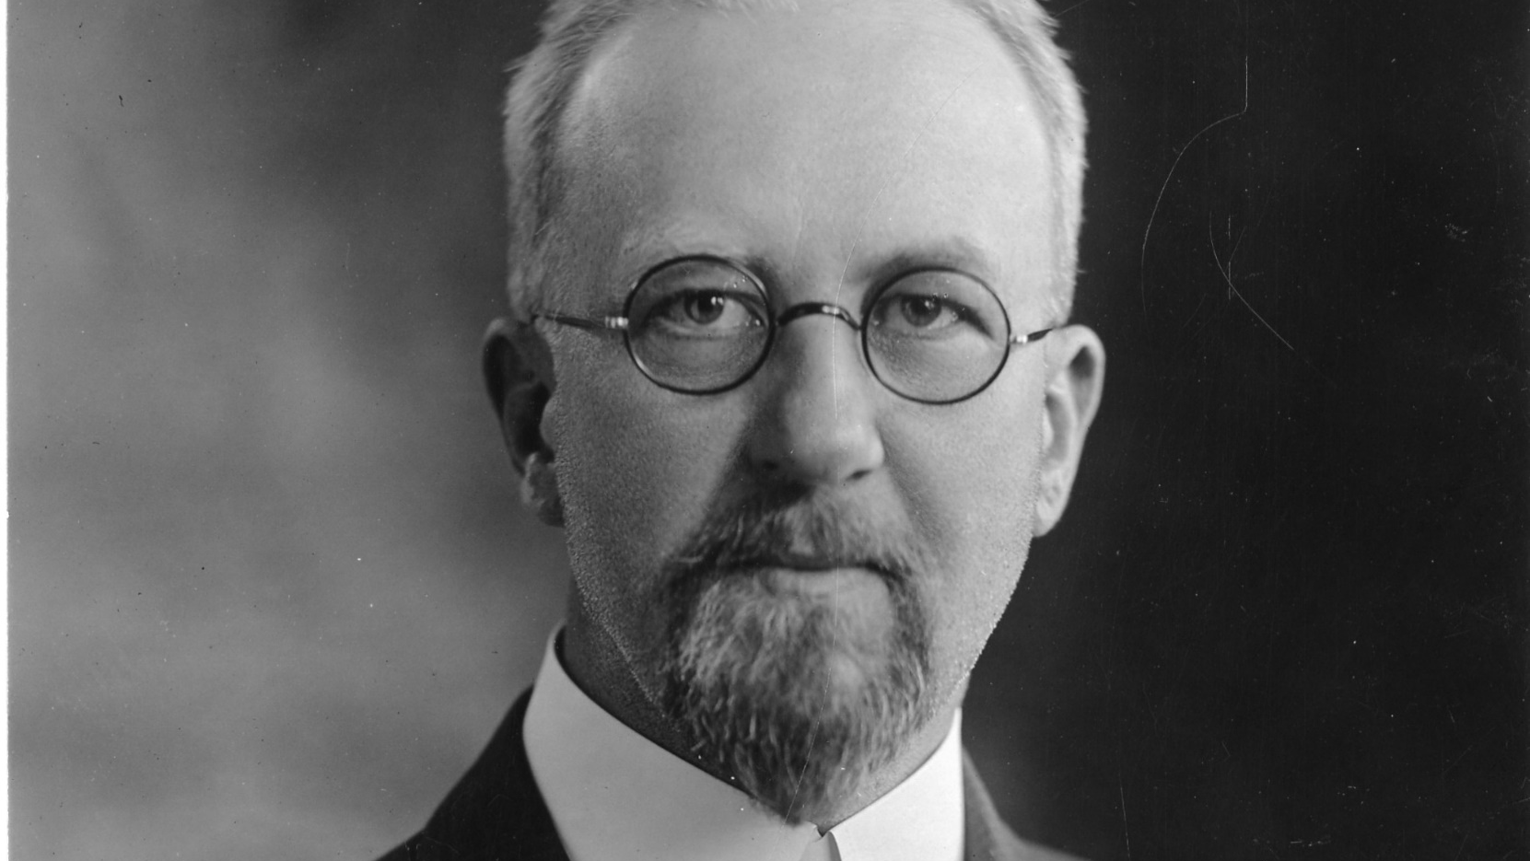
Edward Vermilye Huntington
1874 – 1952
In 1904, he put Boolean algebra
on a sound axiomatic foundation
Notes:
American postulate theorists, devising sets of axioms (which he called "postulates")
In 1904, Huntington put Boolean algebra on a sound axiomatic foundation

Slide 33
postulate
aka. Axiom, Assumption
https://en.wikipedia.org/wiki/Axiom
A statement that is taken to be TRUE
Serve as a premise or starting point for further reasoning
Notes:
An axiom, postulate or assumption is a statement that is taken to be true, to serve as a premise or starting point for further reasoning and arguments. The word comes from the Greek axíōma (ἀξίωμα) 'that which is thought worthy or fit' or 'that which commends itself as evident.'^{[1][2]}

Slide 34
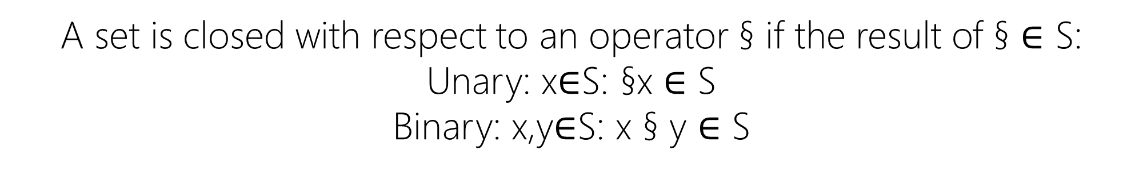
I. closure
A set is closed with respect to an operator § if the result of § $∈$ S:
Unary: x$∈$S: §x $∈$ S
Binary: x,y$∈$S: x § y $∈$ S
Notes:
Section Sign – §
Daggers – †

Slide 35
I. closure
S = {…, -2,-1,0,1,2,…}
§ = + (addition), - (subtraction), × (multiplication), – (negation), ! (fact)
S is closed with respect to +, -, ×, –, !

Slide 36
I. closure
S = {…, -2,-1,0,1,2,…}
§ = ^ (power)
S is NOT closed with respect to ^ for 2^(-1)∉S

Slide 37
I. closure
S = {0,1}
§ = + (OR), × (AND), ‘ (NOT)
S is closed with respect to +, ×, ‘

Slide 38
I. closure
S = {0,1}
§ = – (negation)
S is NOT closed with respect to – for (–1)∉S

Slide 39
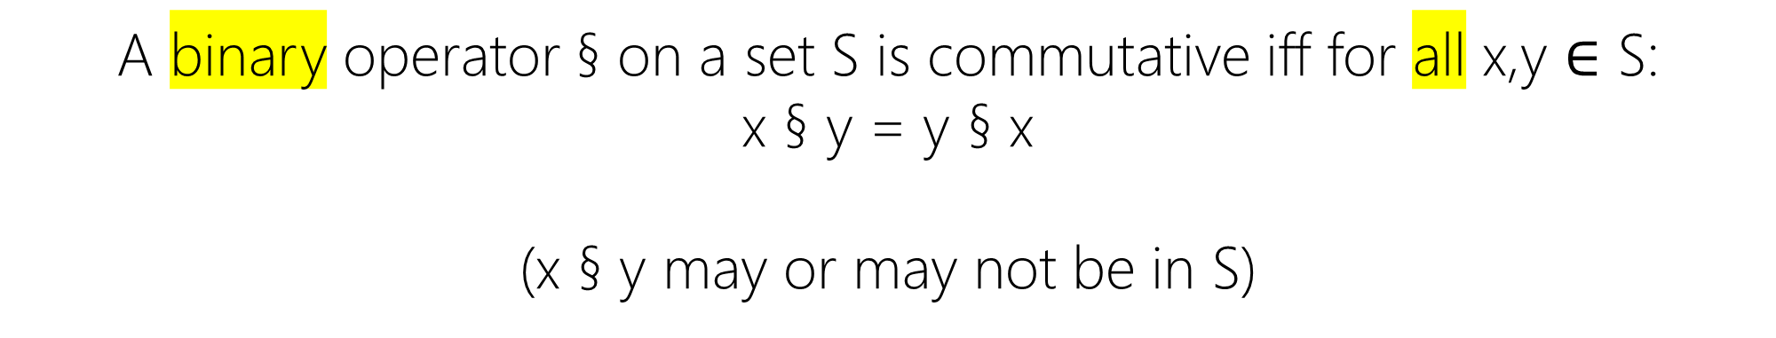
II. Commutative
A binary operator § on a set S is commutative iff for all x,y $∈$ S:
x § y = y § x
(x § y may or may not be in S)

Slide 40
II. Commutative
S = {…, -2,-1,0,1,2,…}
§ = + (addition), × (multiplication)
+ and × are commutative on S for x+y=y+x and x×y=y×x

Slide 41
II. Commutative
S = {…, -2,-1,0,1,2,…}
§ = - (subtraction)
- is NOT commutative on S for x-y≠y-x

Slide 42
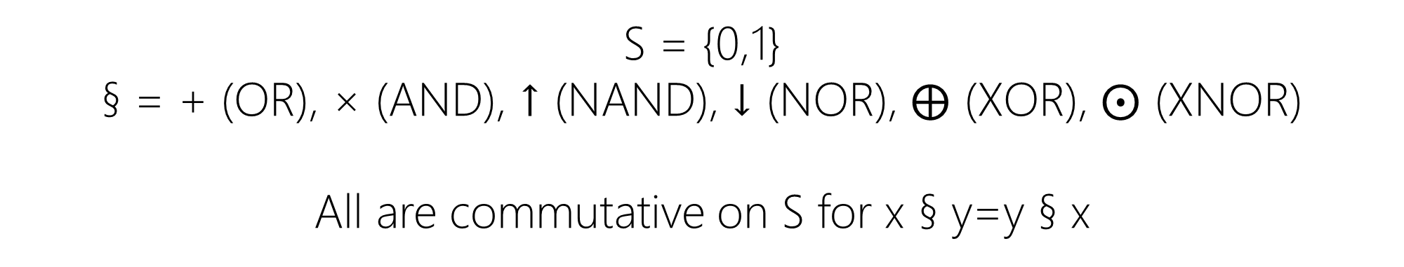
II. Commutative
S = {0,1}
§ = + (OR), × (AND), ↑ (NAND), ↓ (NOR), $⨁$ (XOR), $⨀$ (XNOR)
All are commutative on S for x § y=y § x

Slide 43

III. Associative
A binary operator § on a set S is associative iff for all x,y,z $∈$ S:
x § (y § z)= (x § y) § z = x § y § z

Slide 44
III. Associative
S = {…, -2,-1,0,1,2,…}
§ = + (addition), × (multiplication), - (subtraction)
+, -, × are associative on S for
x±(y±z)=(x±y) ±z=x±y±z
x×(y×z)=(x×y)×z=x×y×z

Slide 45
III. Associative
S = {…, -2,-1,0,1,2,…}
§ = ^ (power)
^ is NOT associative on S for 2^(1^3)≠(2^1)^3

Slide 46
III. Associative
S = {0,1}
§ = + (OR), × (AND)
+,× are associative on S for
x+(y+z)=(x+y)+z=x+y+z
x×(y×z)=(x×y)×z=x×y×z

Slide 47
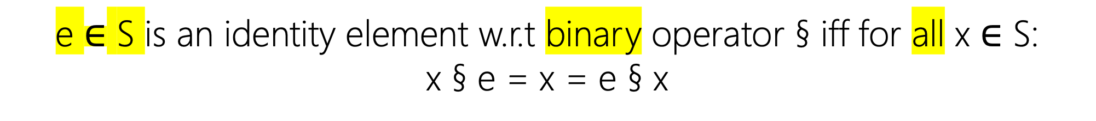
IV. Identity
e $∈$ S is an identity element w.r.t binary operator § iff for all x $∈$ S:
x § e = x = e § x

Slide 48
IV. Identity
S = {…, -2,-1,0,1,2,…}
§ = + (addition), × (multiplication)
e₊= 0 : x+0=0+x=x
e×= 1 : x×1=1×x=x

Slide 49
IV. Identity
S = {…, -2,-1,0,1,2,…}
§ = - (subtraction)
e = 0
x-0≠0-x≠x
NO identity element for – (subtraction) in S

Slide 50
IV. Identity
S = {0,1}
§ = + (OR), × (AND)
e₊= 0 : x+0=0+x=x
e×= 1 : x×1=1×x=x

Slide 51
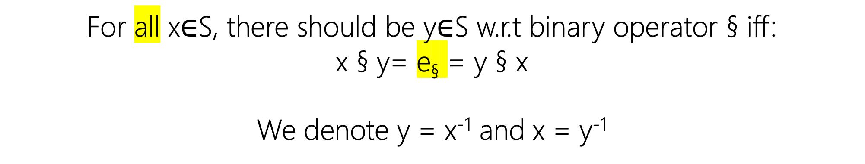
V. inverse
For all x$∈$S, there should be y$∈$S w.r.t binary operator § iff:
x § y= e§ = y § x
We denote y = x⁻¹ and x = y⁻¹

Slide 52
V. inverse
S = {…, -2,-1,0,1,2,…}
§ = + (addition)
x+(-x)=(-x)+x= e₊= 0
x⁻¹=-x

Slide 53

V. inverse
S = {…, -2,-1,0,1,2,…}
§ = × (multiplication)
S does not have the inverse property for × since
2×½ = ½×2= e×= 1 but ½ $∉$ S

Slide 54
V. inverse
S = {0,1}
§ = + (OR), × (AND)
1+?=?+1 ≠ e₊= 0
0×?=?×0 ≠ e×= 1

Slide 55
VI. Distributive
If § and † are two binary operators on a set S, § is distributive over † iff:
x § (y † z) = (x § y) † (x § z)= (y † z) § x

Slide 56
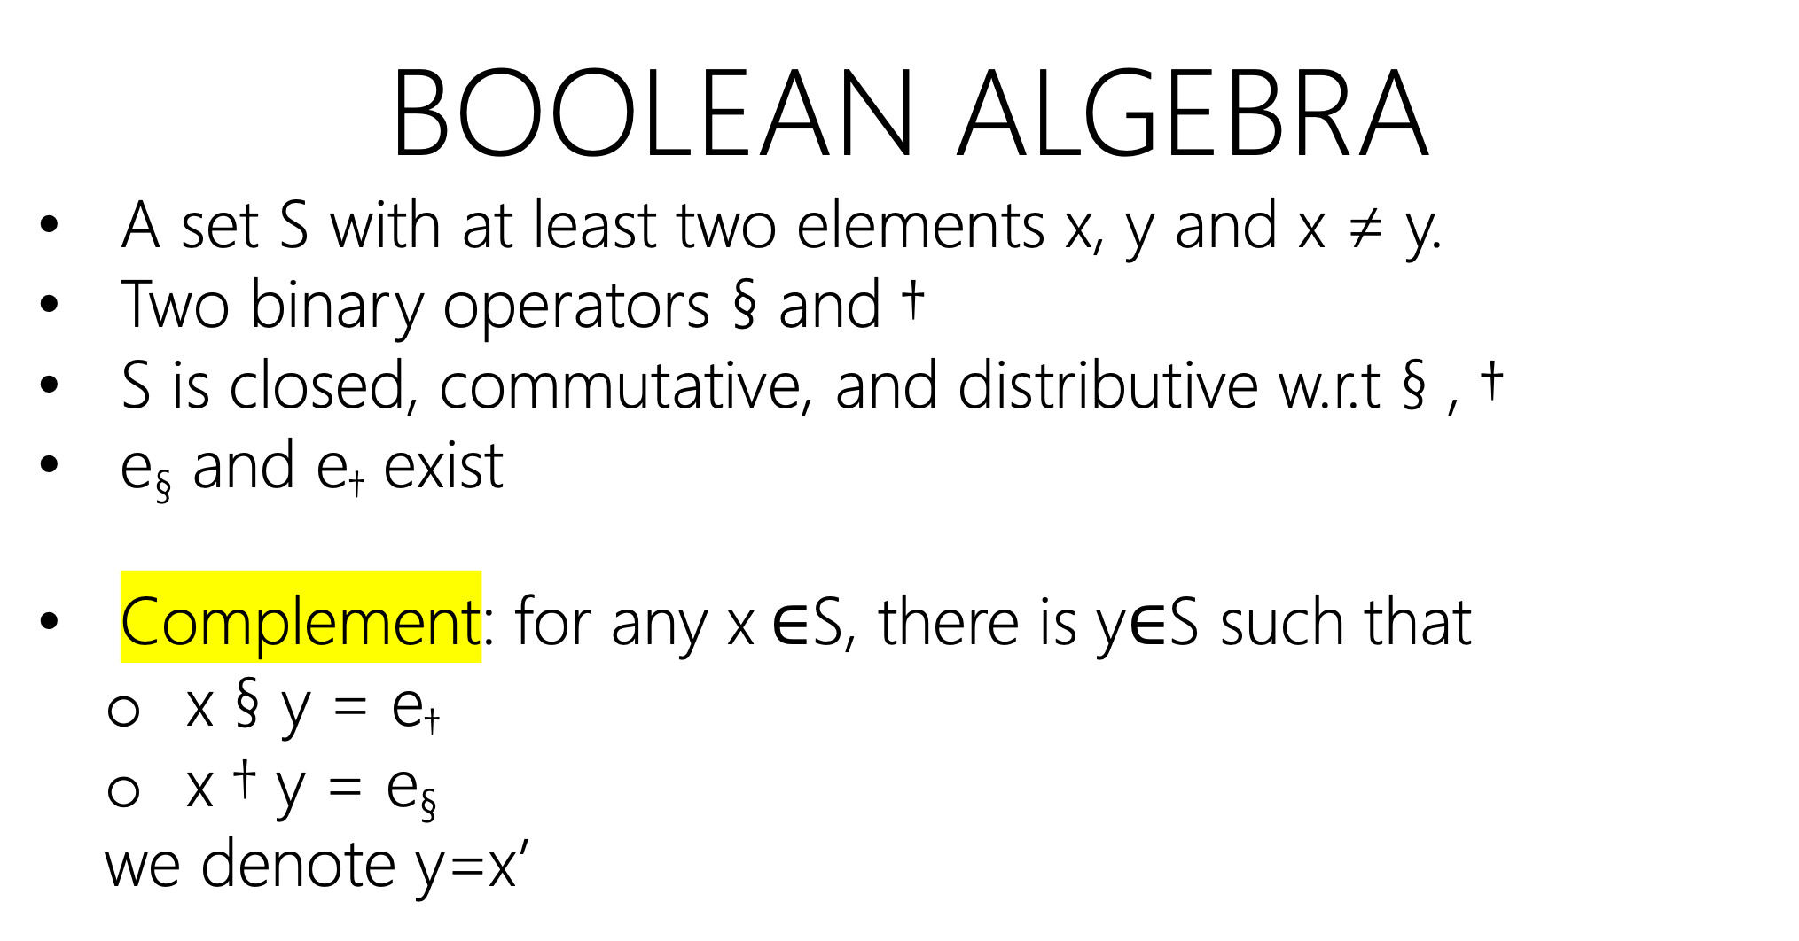
Boolean algebra
A set S with at least two elements x, y and x ≠ y.
Two binary operators § and †
S is closed, commutative, and distributive w.r.t § , †
e§ and e† exist
Complement: for any x $∈$S, there is y$∈$S such that
x § y = e†
x † y = e§
we denote y=x’

